Slide 1

Vegetarian Food Recommender
Sanskriti Shukla - 114
Atharv Wadekar - 128
Palak Upadhyaya - 123
Prachi Singh - 115
Project Guide
Ms. Sayali B.

Slide 2
Outline
Introduction
Problem Statement
System Design
Technologies and Methodologies
Key Features
Implementation Screenshots
Conclusion
References

Slide 3
Introduction
Personalized Meal Recommendations: The system suggests healthy vegetarian meals based on user preferences, dietary restrictions, and goals, ensuring a tailored experience.
Nutritional Insights: It provides information for each meal, helping users make informed decisions about their food choices.
Recipe Database & Substitutions: Access to a vast recipe database with healthy ingredient substitutions, allowing users to create meals based on available ingredients.

Slide 4
Problem statement
Consumers often face challenges finding healthy vegetarian substitutes for non-vegetarian foods.
This app aims to simplify the process by offering curated, nutritious vegetarian alternatives.
It provides users with informed recommendations based on dietary preferences and health needs.
It helps users make better dietary choices without compromising taste or nutrition.

Slide 5
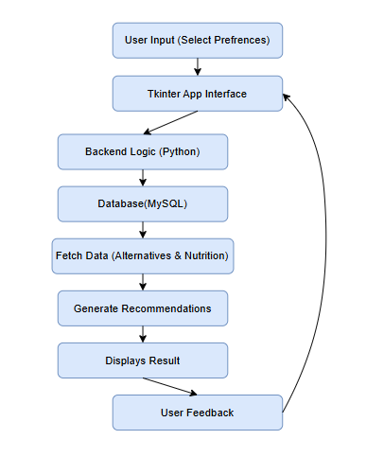
Overview of System Design

Slide 6



Technologies and Methodologies
Tkinter : Tkinter is a standard Python library used to create graphical user interfaces (GUIs). It provides various widgets like buttons, labels, and text boxes to design interactive applications.
MySQL : In this project, MySQL is used to handle back-end data storage, perform queries, and manage the database. It ensures efficient data retrieval, insertion, and updating while maintaining data integrity.

Slide 7

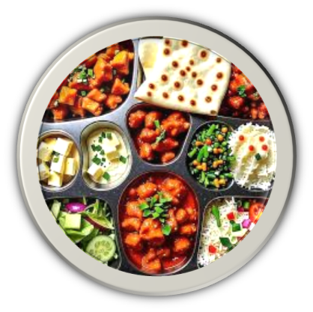
Key Features
Personalized Filters: Users can refine results based on dietary needs (eg: low-calorie, high-protein).
Healthier Alternatives: Suggestions align with vegetarian and healthy eating guidelines.
Nutritional Info: Detailed analysis of calories, protein, fat, and vitamins for each alternative.
Availability & Pricing: Displays where to buy alternatives and their prices.
User Reviews: Each suggestion includes ratings and feedback from users.

Slide 8
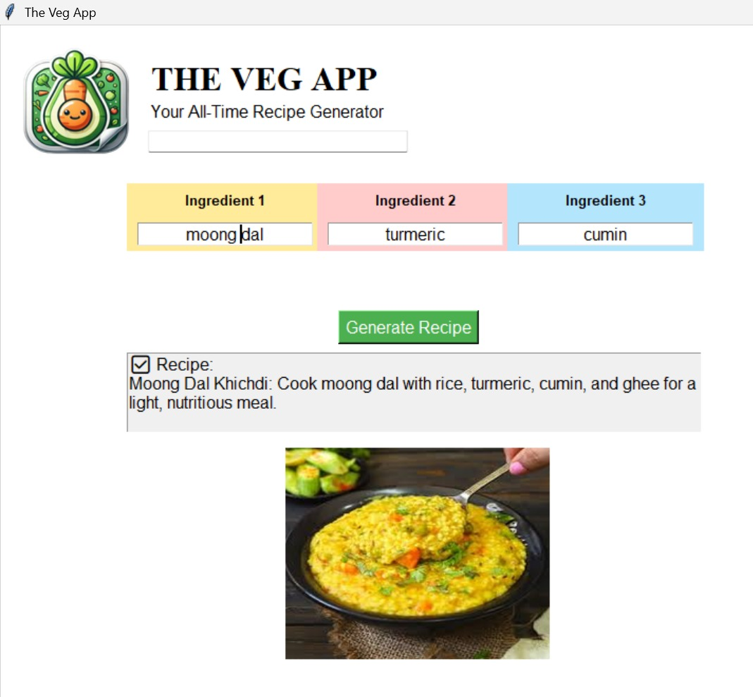
Implementation Screenshots

Slide 9
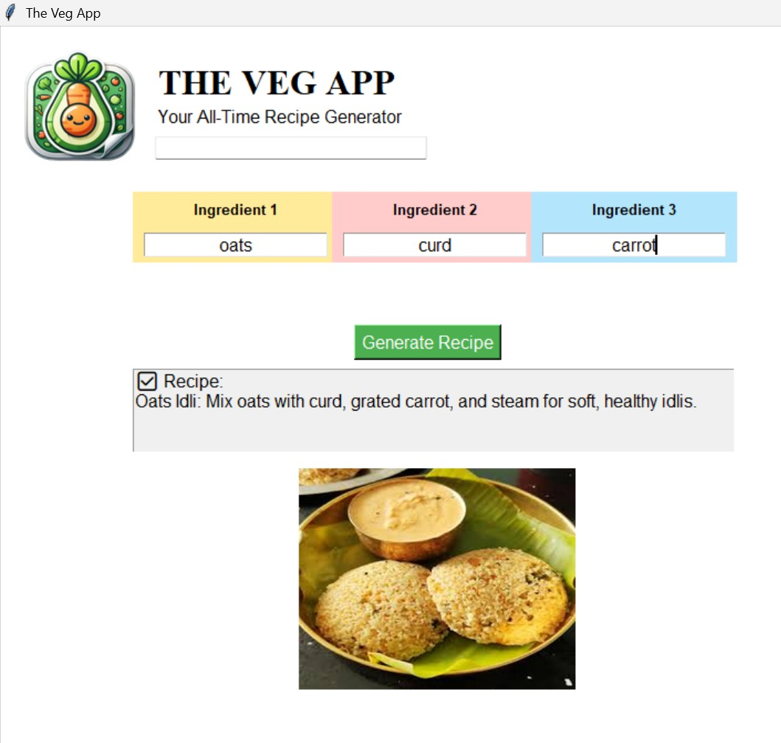

Slide 10
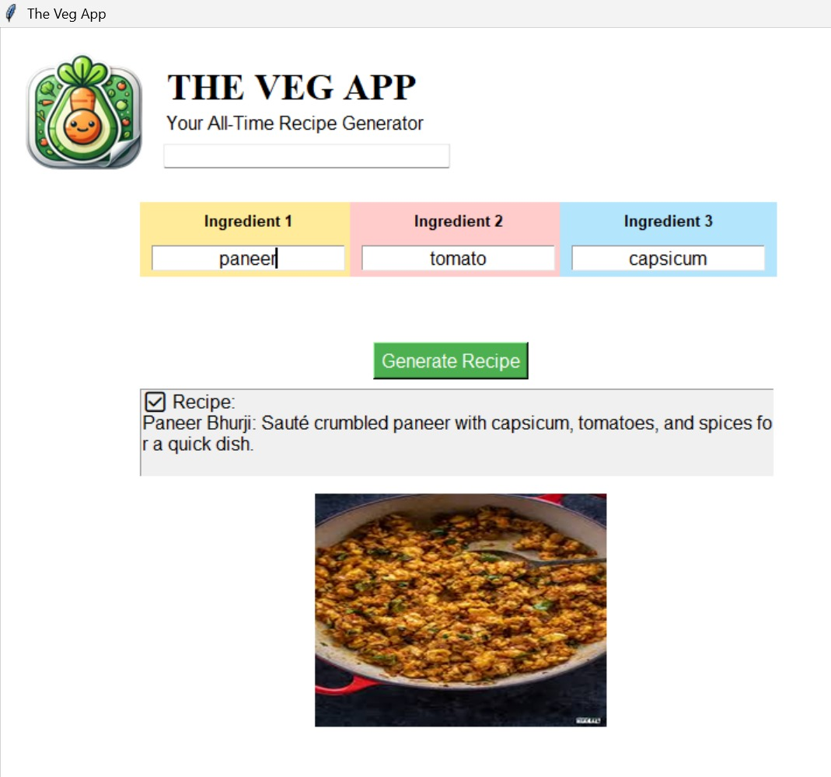

Slide 11
Conclusion
In conclusion, this project offers a personalized approach to healthy eating by providing tailored vegetarian meal recommendations, detailed nutritional insights, and a flexible recipe database with ingredient substitutions.
It empowers users to make informed food choices, supports a plant-based lifestyle, and promotes healthier eating habits in a convenient, accessible way.

Slide 12
References
Author(s) | Title | Year
Sidharth Prabhu, Sindhu Vaibhav KL, Medusa Infosystems International | Food Ordering System with Python and MySQL | 2022
Tejeswari Naidu S, Pavan Kota, Navya Ramani G, Navya Sri B, Manohar Konala | Zomato Clone with Python Tkinter and MySQL | 2022
Maanasa Poluparti, Lingxi Zhou, Abhinav Tadi, Rudaina Saleh | QuickBite | 2022

Slide 13
Thank You...!!

